Slide 1



Slide 2

Online Smart Chef Services
Supervised by:
Miss. Anum Zahra
Group Members:
Attique ur rehman ( FA17-BCS-025 )
Muqadus Umar ( FA17-BCS-019 )
Department of Computer Science
COMSATS University Islamabad, Attock Campus

Slide 3
Outline
Introduction
Comparison table
Problem statement
Objectives
Methodology
Modern tools
Benefits
Diagrams
References
_______________________________

Slide 4

Introduction
The "Online Smart Chef Services“ simplifies the ordering process for both the chef and the customer .It allows customer to easily order any menu at any event.
This allows chefs to rapidly experience the orders as they are received and process all orders effectively with minimal delays.
It provides recommendation systems chef-wise, interest-based, and area-wise i-eRecommendation of chef to users and recommendation of dishes, and nearby local dishes,events based upon reviews and ratings, and easy profile management for the chefs and the customers.
_______________________________

Slide 5
Applications And Comparison Table
Functionality | Smart Cheff Services (Proposed) | SooperChef | Swiggy | Plate101
Registration for both users and Chefs | ✔ | ✔ | ✖ | ✔
Recommend Chef to users | ✔ | ✖ | ✖ | ✖
Watch Recommended recipes | ✔ | ✖ | ✔ | ✖
Add to cart | ✔ | ✔ | ✔ | ✔
Reviews and feedbacks | ✔ | ✖ | ✔ | ✔
Target small cities as well | ✔ | ✖ | ✖ | ✖
Recommend nearby local dishes | ✔ | ✖ | ✖ | ✖
_______________________________

Slide 6
Problem statement
For putting in any requests clients need to visit hotels or restaurants to think about food things and at that point place request and pay. In this strategy a lot of time and manual work is required. How to overcome this?
How to overcome with the chef shortage problem?
While putting in a request via telephone, client comes up short on the actual duplicate of the menu item, absence of visual affirmation that the request was put accurately.
_______________________________

Slide 7
Objectives
The main aims and objectives of our system are as under :
Provide an online android based freelancing platform to the chefs.
To build up an application that satisfy the customer and managed a large number of orders without wasting time.
To introduce location based recommendations.
To rate the chef performance with the help of feedbacks and reviews.
_______________________________

Slide 8
Development Requirements
Software Requirements dependence:
IDE: Android Studio 4.2
Programming language: Python, Java, XML
Database: Firebase Database
Hardware Requirements dependence:
Smart Mobile Phone: Android Studio
Internet

Slide 9
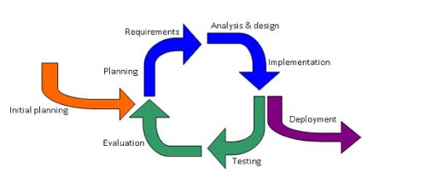
Methodology
Chef panel design
User panel design
Database design
Evaluation and testing

Slide 10
Tools and Technologies
Tools & Technologies | Rationale
Java and python | Programming language
MS word | Documentation work
MS PowerPoint | Presentation work
UML | Diagram work
Android Studio | Programing tool
Firebase Real Time Database | Backend work

Slide 11
Benefits
Provides android based freelancing platform for Cheffs.
Location based recommendations and offers.
Better services and communication.
To leave a review and feedback in case of any issue.
Less time-consumption for customers.
_______________________________

Slide 12
Diagrams
Use Case Diagrams
Chef Use Case Diagram
Customer Use Case Diagram
Activity Diagrams
Chef Activity Diagram
Customer Activity Diagram
Class Diagram
Sequence Diagram

Slide 13
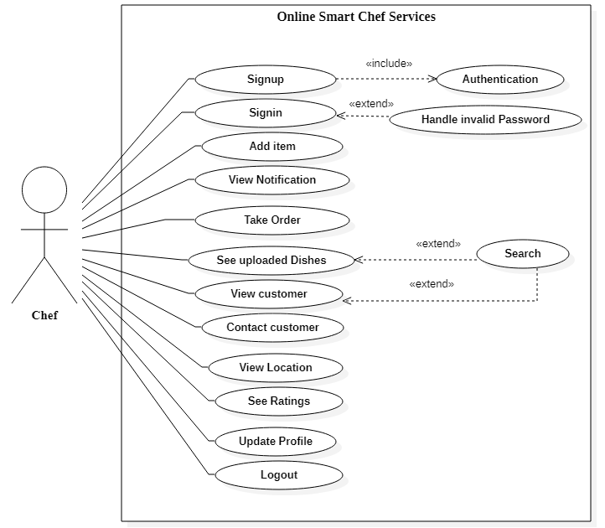
Chef Use case Diagram

Slide 14
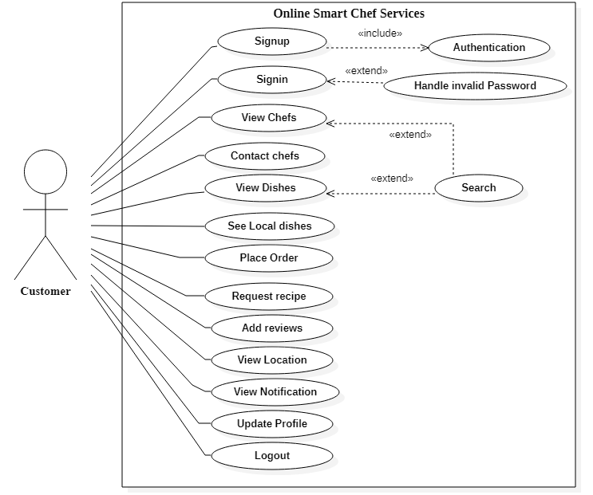
Customer Use case Diagram

Slide 15
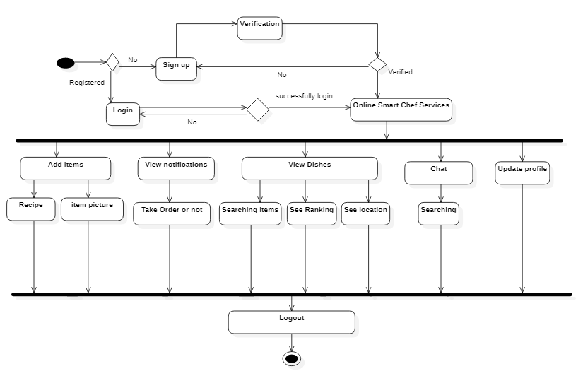
Chef Activity Diagram

Slide 16
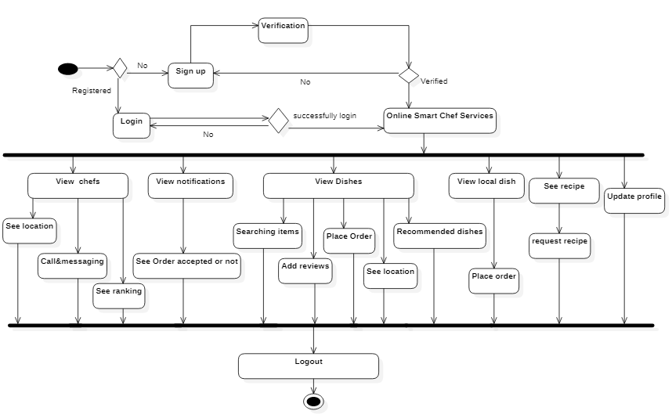
Customer Activity Diagram

Slide 17
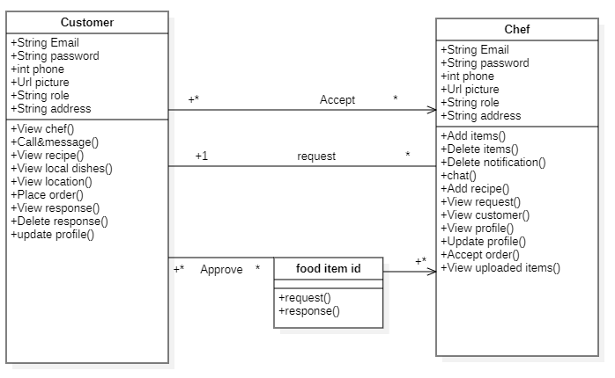
Class Diagram

Slide 18
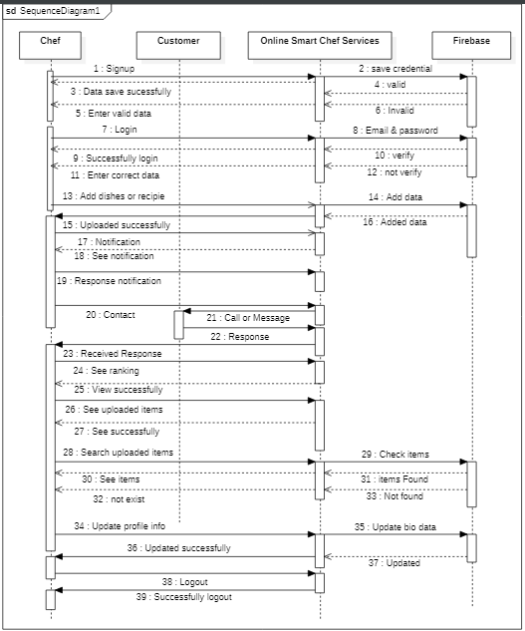
Chef Sequence Diagram

Slide 19
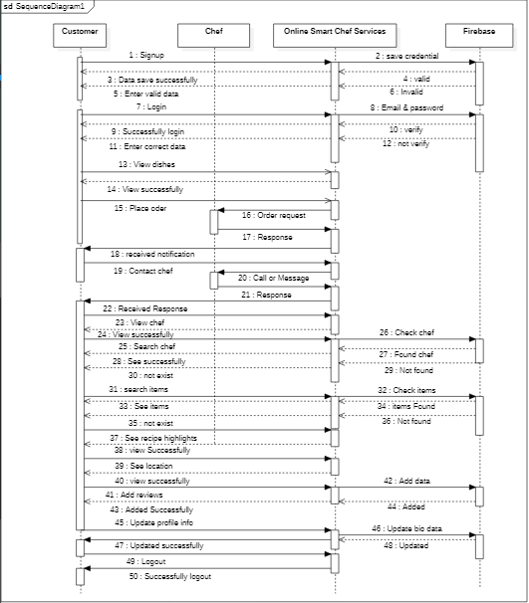
Customer Sequence Diagram

Slide 20
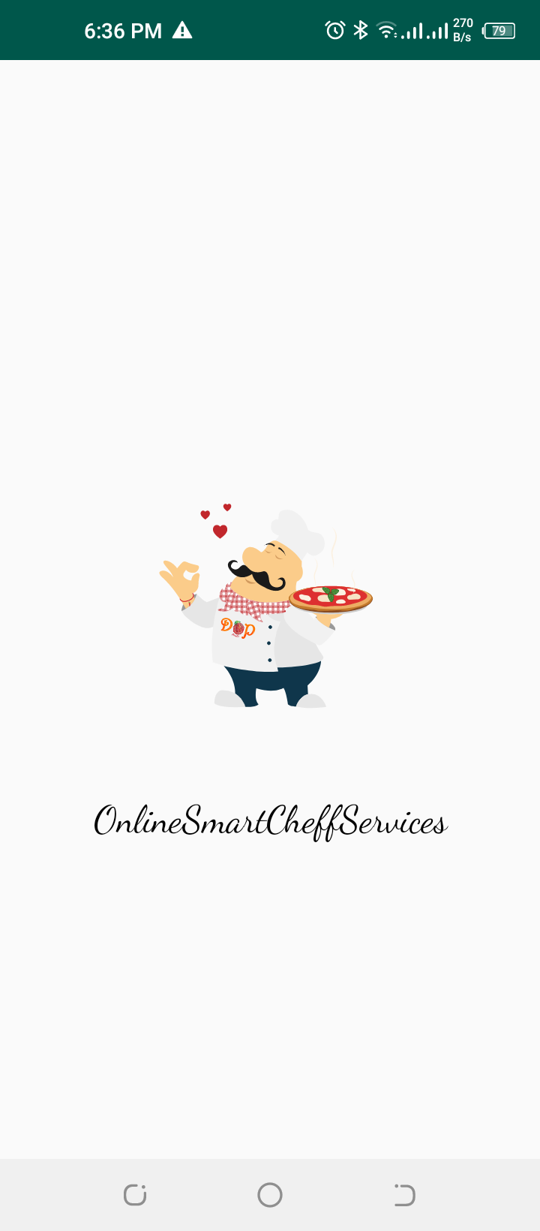
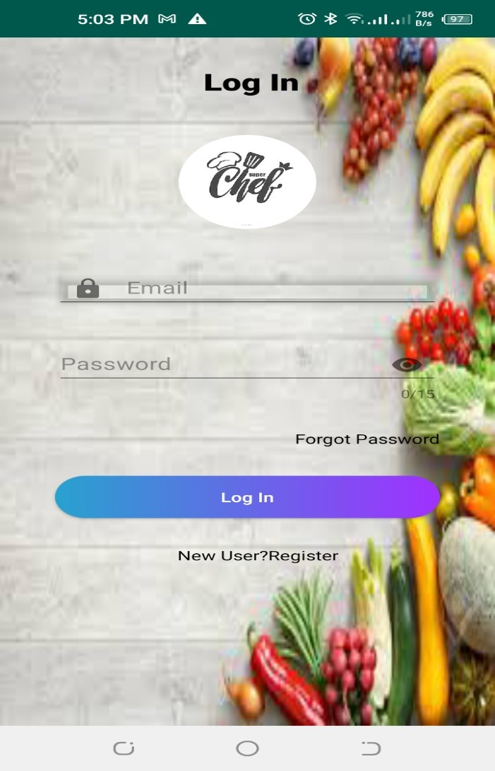
Splash Screen and Login

Slide 21
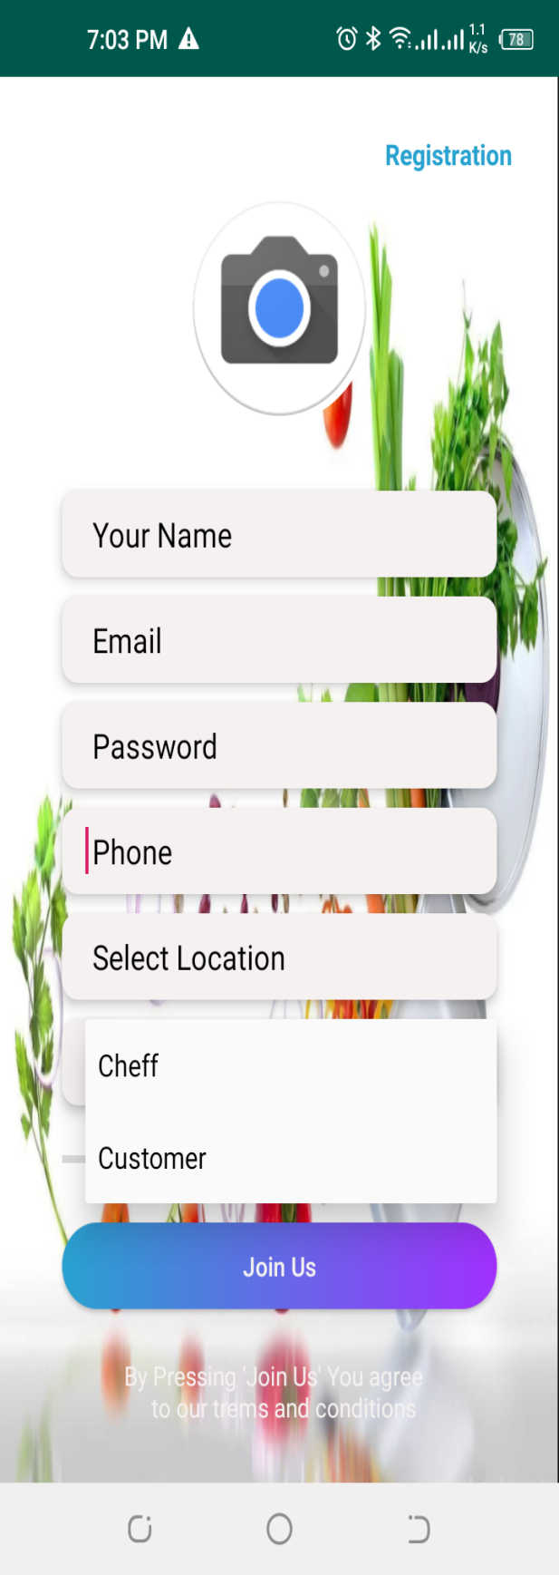
Registration

Slide 22
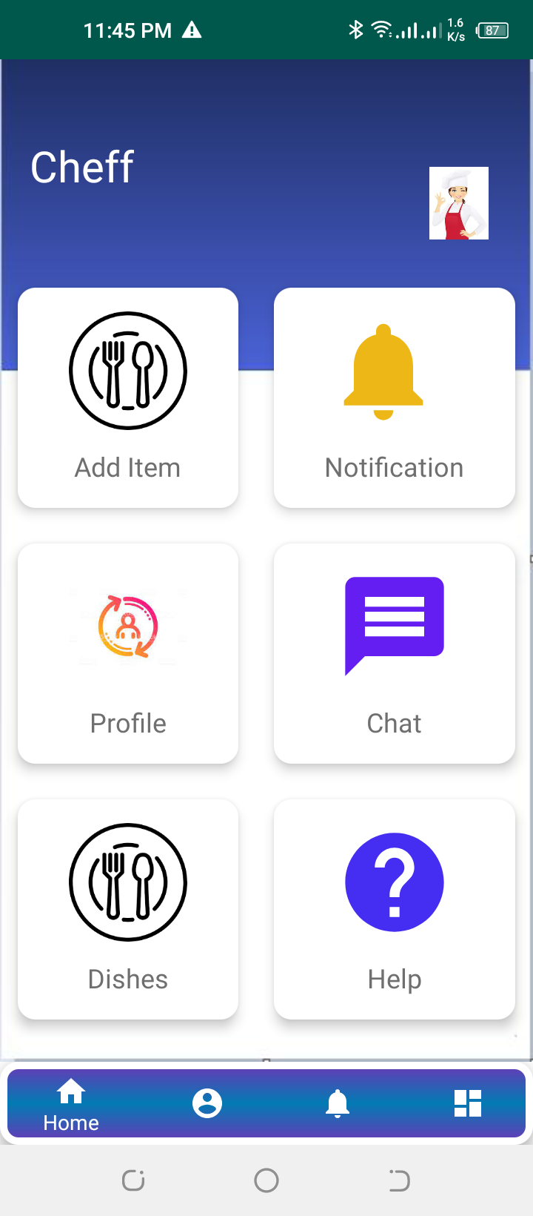
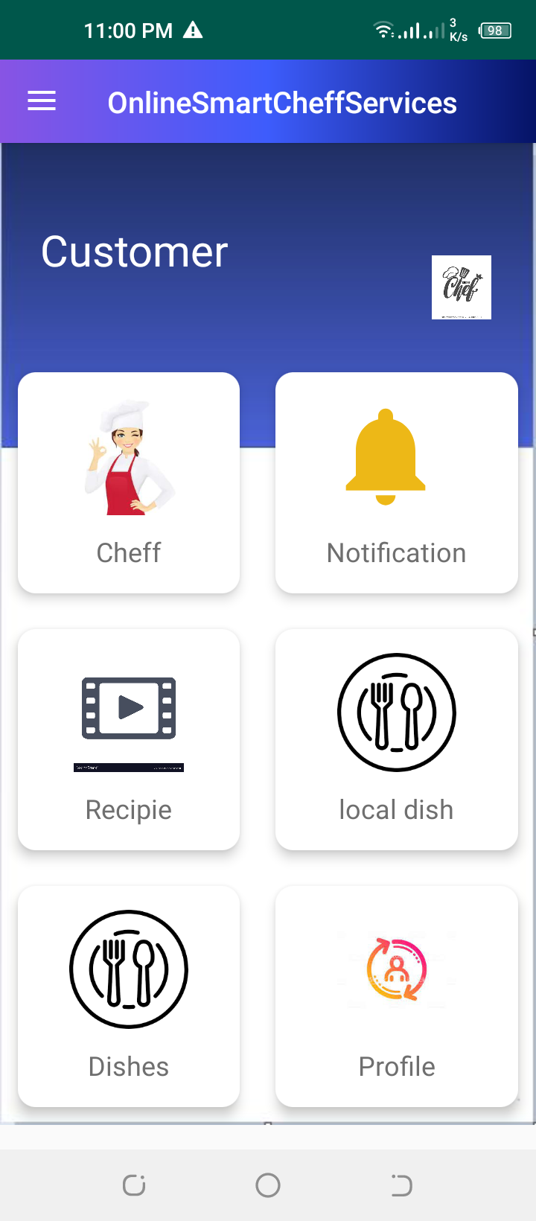
DashBoard

Slide 23
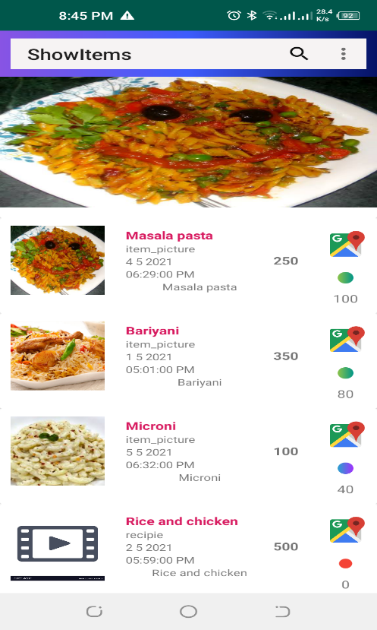
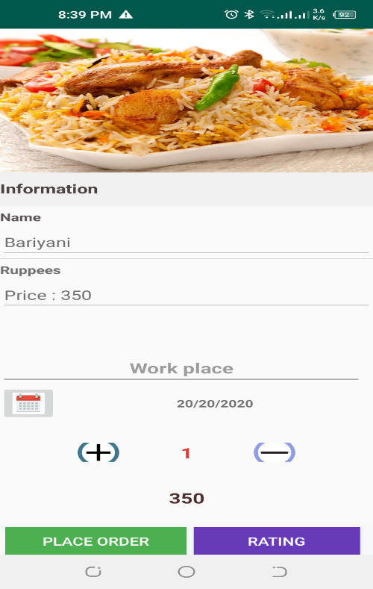
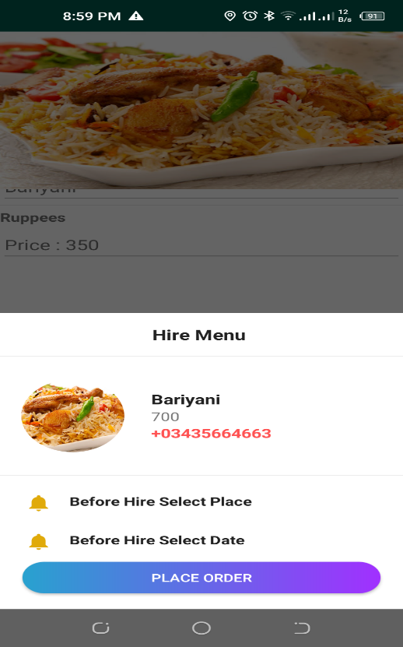
View Dishes and Place order

Slide 24
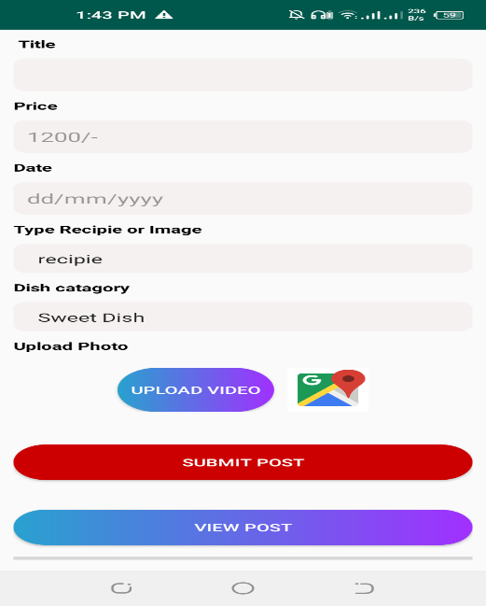
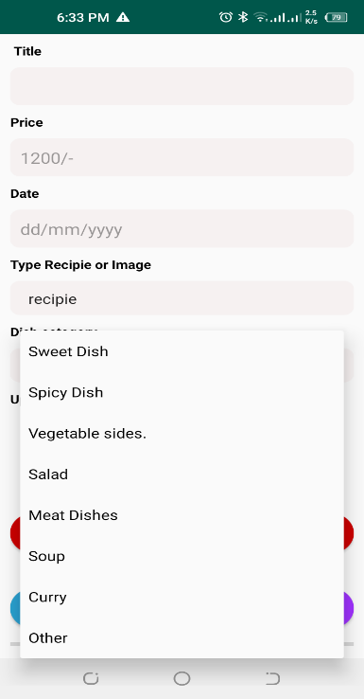
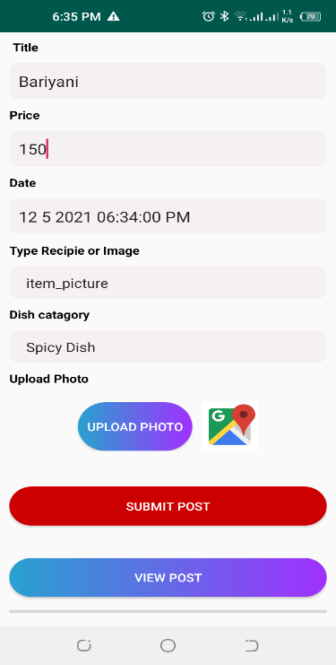
Add items

Slide 25
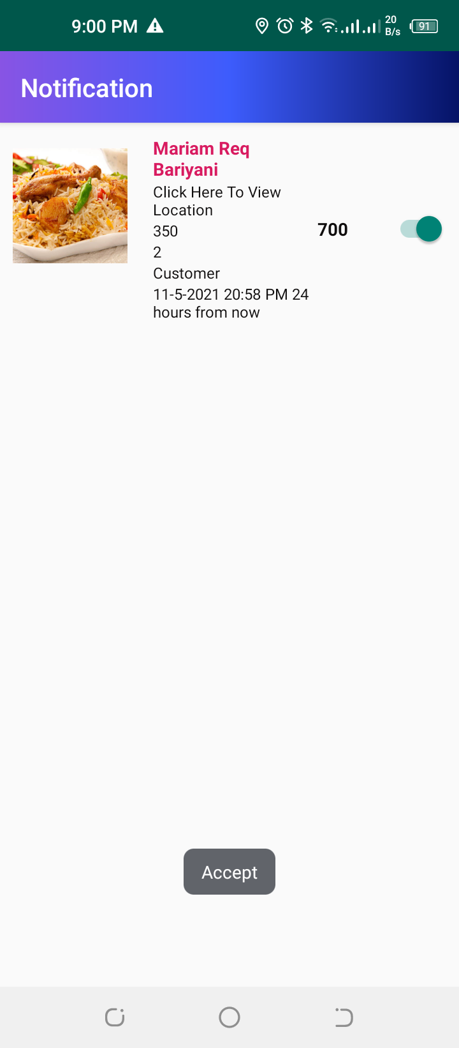
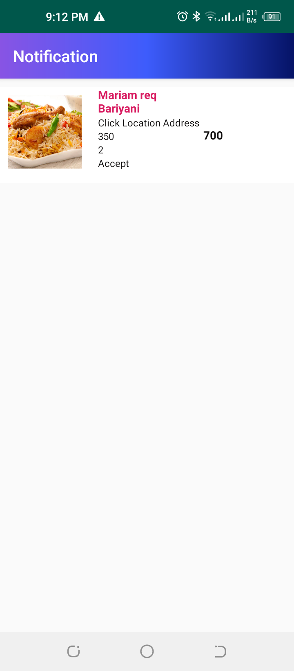
Notification

Slide 26
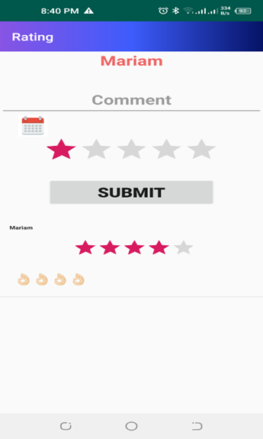
Reviews

Slide 27
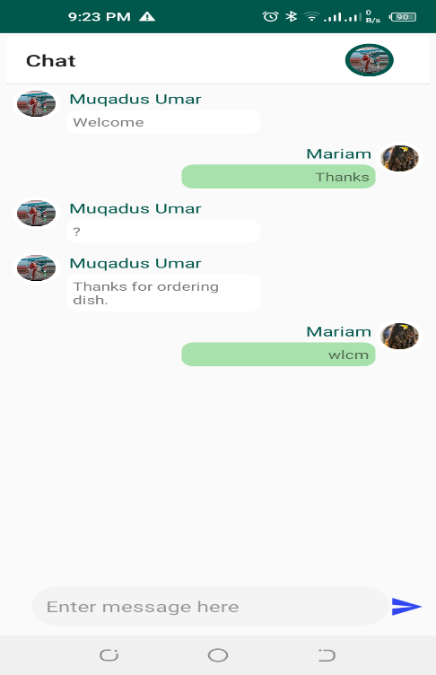
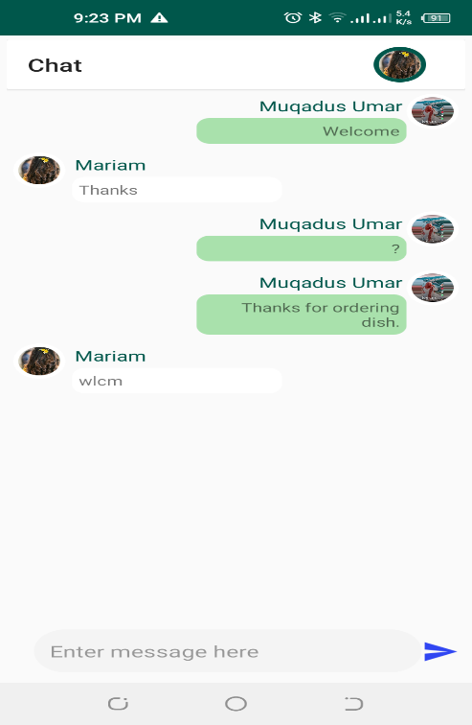
Chat

Slide 28
References
1. Location Based Services using Android Mobile Operating System by Amit Kushwaha, Vineet Kushwaha from Department of Electronics & Communication Engineering IIMT Engineering College, Meerut-250001, India. International Journal of Advances in Engineering & Technology, Mar 2011. IJAET ISSN: 2231-1963
2. Location Based Tracking Application Using Android Mobile Operating System by Apoorva Vengurlekar, Kiran Shukla, Dnyaneshwar J. Dhangar from Rajiv Gandhi Institute of Technology, Mumbai. International Journal of Scientific & Engineering Research, Volume 5, Issue 3, March-2014 821 ISSN 2229-5518.
3. Automated Food Ordering System with Interactive User Interface Approach by YoungChai Tan, KienLoong Lee, ZhiChao Khor, KaeVin Goh, KhimLengTan, BentFie Lew from Department of Engineering and Science University Tunku Abdul Rahman (UTAR),
4. Whitten, Jeffrey L. and Lonnie D. Bentley. (2007). System Analysis and Design Methods. (6th edition).New York: McGraw-Hill Irwin.
5. Yadav, Manish. (2011). History of Android. Retrieved on 10-11-2012 from http://www.tech2crack.com/history-android/
_______________________________

